Slide 1
Supervised Learning
Multi Layer Perceptron
S.V.Jansi Rani
Associate Professor / CSE
UCS 1603 Introduction to Machine Learning

Slide 2
Agenda
NN structure
Gradient Descent
Activation Functions
MLP Algorithm

Slide 3







Slide 4
Multi-layer Perceptron

Slide 5
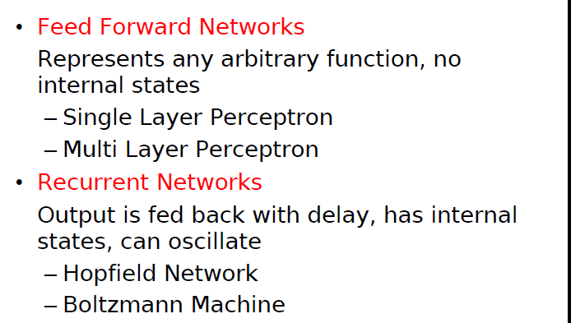
Network structure

Slide 6
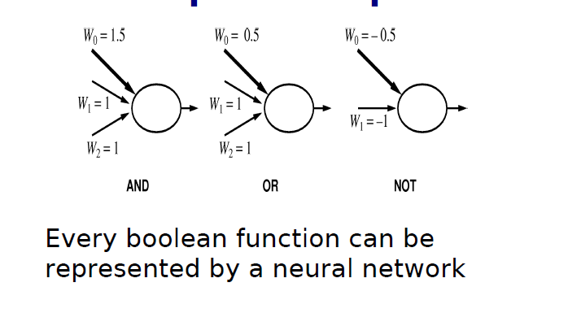
Example – Boolean function

Slide 7
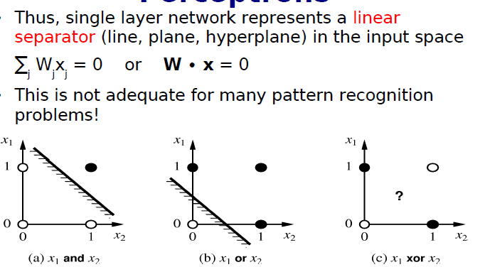
Contd..

Slide 8
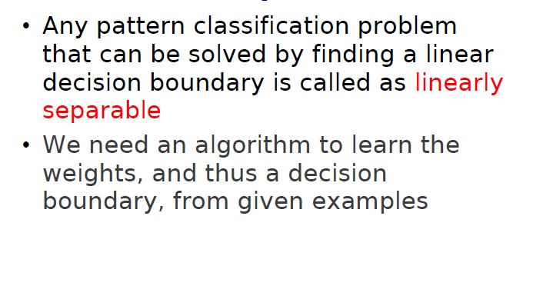
Contd..

Slide 9
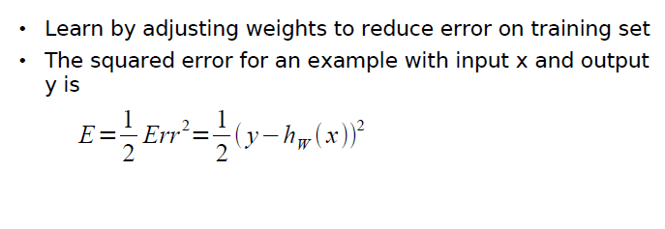
Contd..

Slide 10
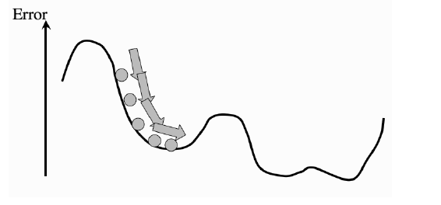
Gradient descent
weights of the network are trained so that the error goes downhill until it reaches a local minimum, just like a ball rolling under gravity.
back-propagation of error, which makes it clear that the errors are sent backwards through the network.

Slide 11
How to construct a neural network?

Slide 12
Contd…
Each unit performs computation using three steps:
Input function is computed by summing the weights and input values - Linear function.
Activation function computes the actual output using any one of the activation function from the available three functions (step, sign and sigmoid) - Nonlinear function.
A fixed threshold value is introduced in each level instead of having it in each unit.
ini = åj wj,i
ai = g(ini)

Slide 13
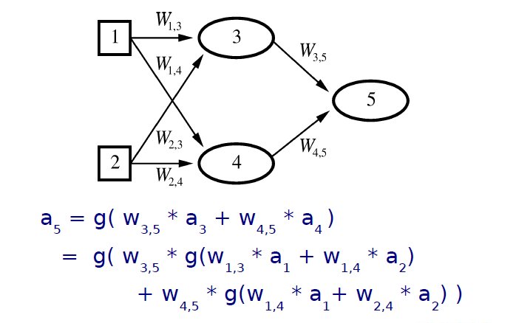
Feed forward network - example

Slide 14
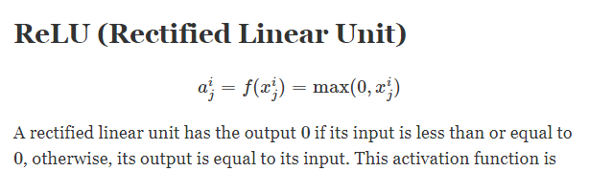
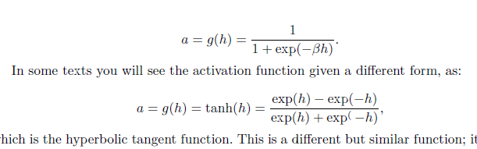
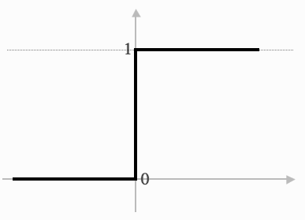
Activation Functions
Binary step function
Binary sigmoid function
Bipolar sigmoid function
https://adl1995.github.io/an-overview-of-activation-functions-used-in-neural-networks.html

Slide 15
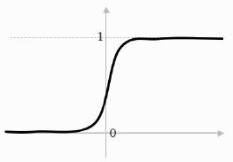
Contd…
The sigmoid function,
which looks qualitatively fairly similar, but varies smoothly and differentiably

Slide 16
Back propagation network
Training a network by back propagation involves 3 stages:
Feed forward of the input training pattern
Back propagation of the associated error
Adjustment of weights

Slide 17
Multi Layer Network

Slide 18
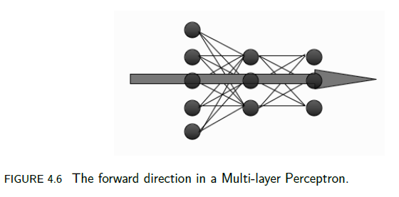

Slide 19
MLP training algorithm using back-propagation
An input vector is put into the input nodes
Inputs are fed forward through the network
Inputs and the first-layer weights (here labelled as v) are used to decide whether the hidden nodes fire or not. The activation function g(·) is the sigmoid function
Outputs of these neurons and the second-layer weights (labelled as w) are used to decide if the output neurons fire or not

Slide 20
Contd…
Error is computed as the sum-of-squares difference between the network outputs and the targets
This error is fed backwards through the network in order to first update the second-layer weights and then afterwards, the first-layer weights

Slide 21
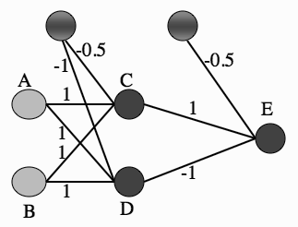
MLP – XOR problem
Multi-layer Perceptron network showing a set of weights that solve the XOR problem.

Slide 22
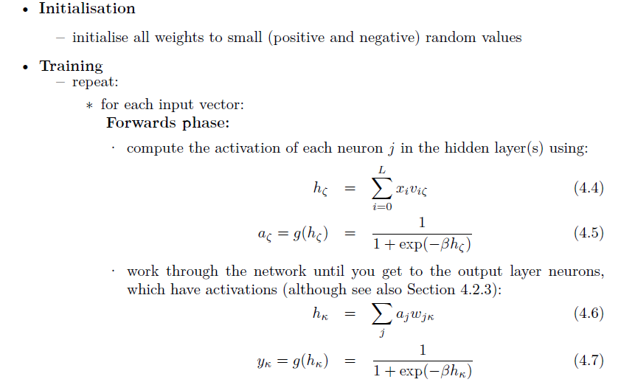
Multi-layer Perceptron Algorithm

Slide 23
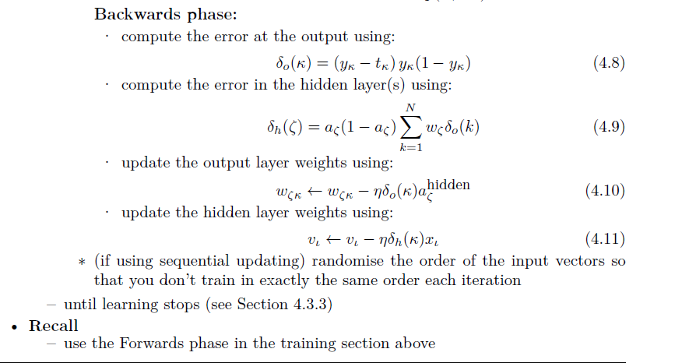
Contd…

Slide 24
MLP Training Algorithm
1. An input vector is put into the input nodes
2. Inputs are fed forward through the network (Figure 4.6)
• the inputs and the first-layer weights (here labelled as v) are used to decide
whether the hidden nodes fire or not. The activation function g(·) is the sigmoid function given in Equation (4.2) above
• the outputs of these neurons and the second-layer weights (labelled as w) are used to decide if the output neurons fire or not
3. Error is computed as the sum-of-squares difference between the network outputs and the targets
4. Error is fed backwards through the network in order to
• first update the second-layer weights
• and then afterwards, the first-layer weights

Slide 25
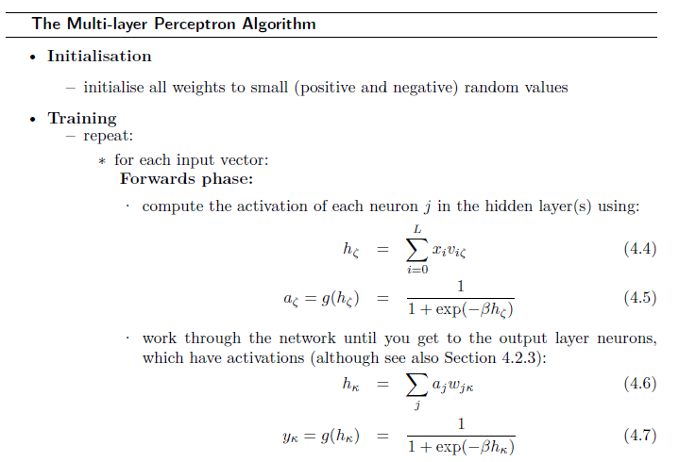
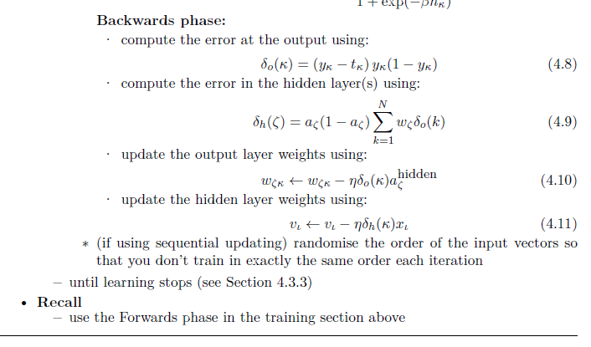

Slide 26


Slide 27
Summary
NN structure
Gradient Descent
Activation Functions
MLP Algorithm

Slide 28
Check your understanding

Slide 29
THANK YOU
Courtsey : Stephen Marsland

